Slide 1
BWAPP
2018.04.2pa2

Slide 2
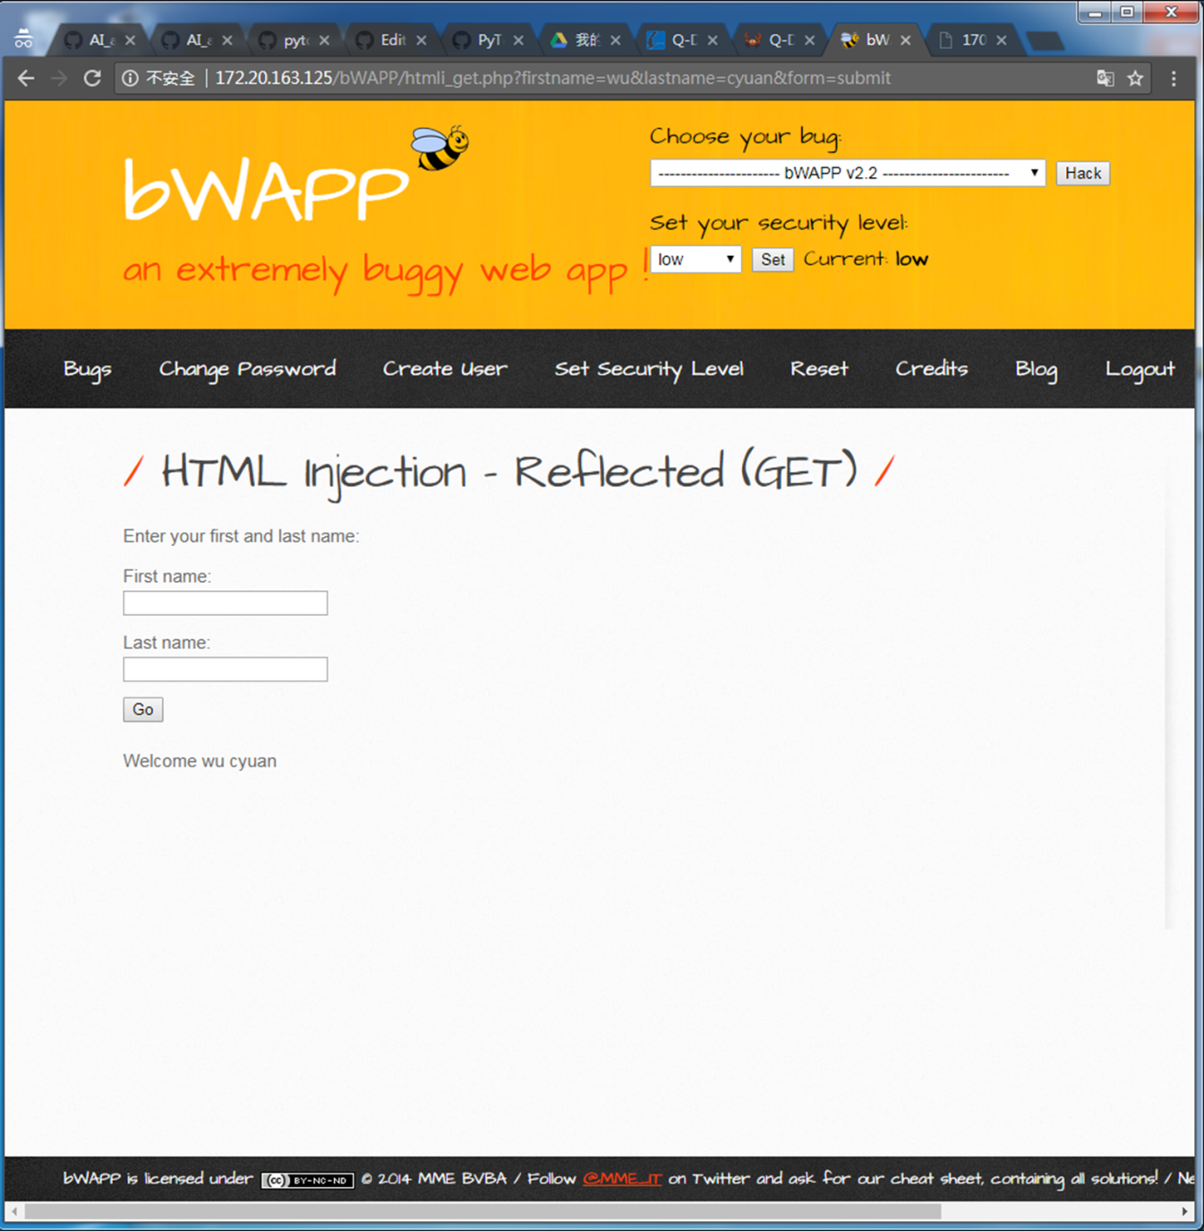
HTML Injection - Reflected (GET)
→htmli_get.php

Slide 3
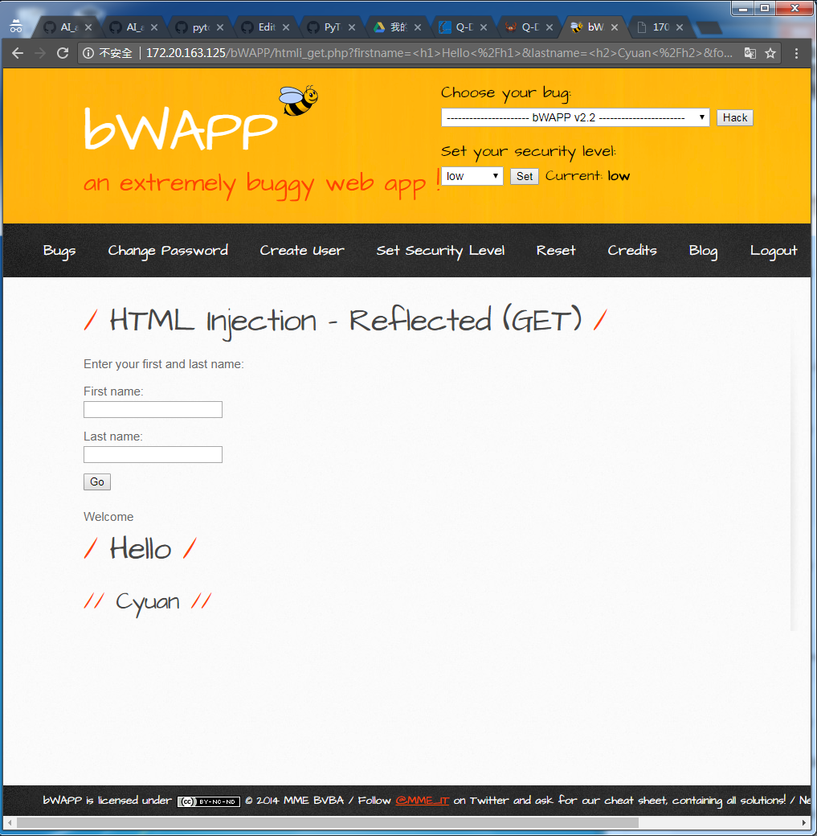
HTML Injection - Reflected (POST)
→
/bWAPP/htmli_get.php?firstname=%3Ch1%3EHello%3C%2Fh1%3E&lastname=%3Ch2%3EWorld%3C%2Fh2%3E&form=submit
→
first = <h1>Hello</h1>
Last = <h2>Cyuan</h2>

Slide 4
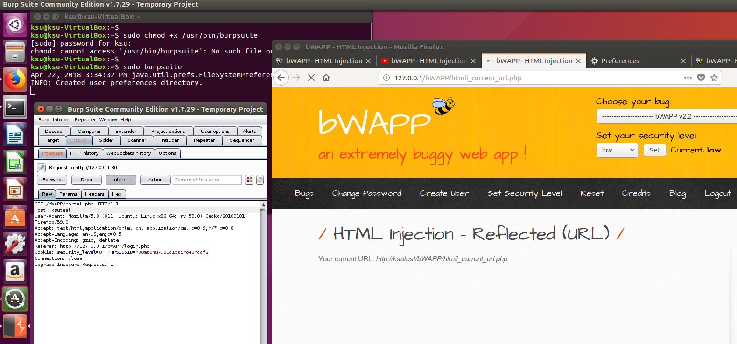
HTML Injection - Reflected (URL)
→安裝burp Suite
→firefox的網路設定更改為127.0.0.1
→執行程式並將Intercept is off 開成 on
→接著把原本的127.0.0.1更改為自己想要的再送出即可

Slide 5
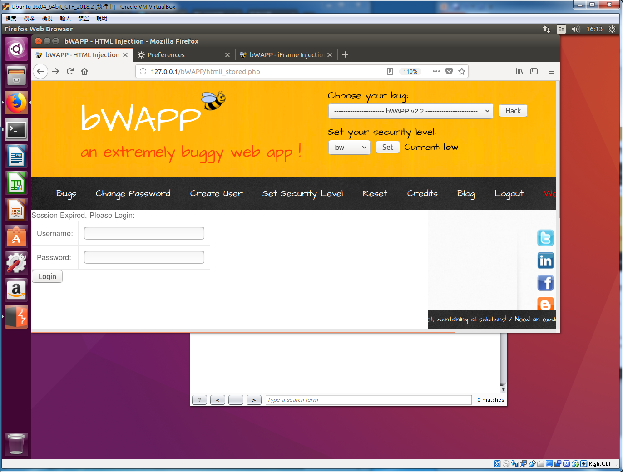
HTML Injection - Stored (Blog)

Slide 6
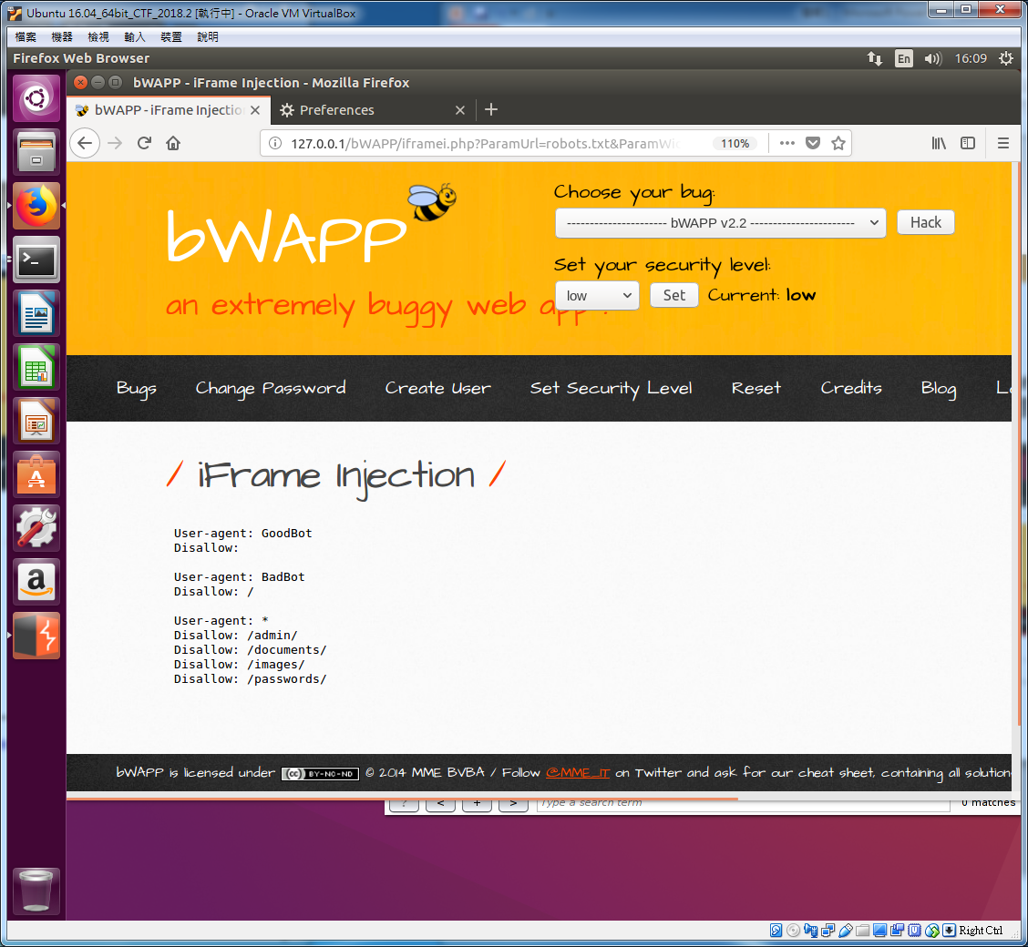
iFrame Injection

Slide 7
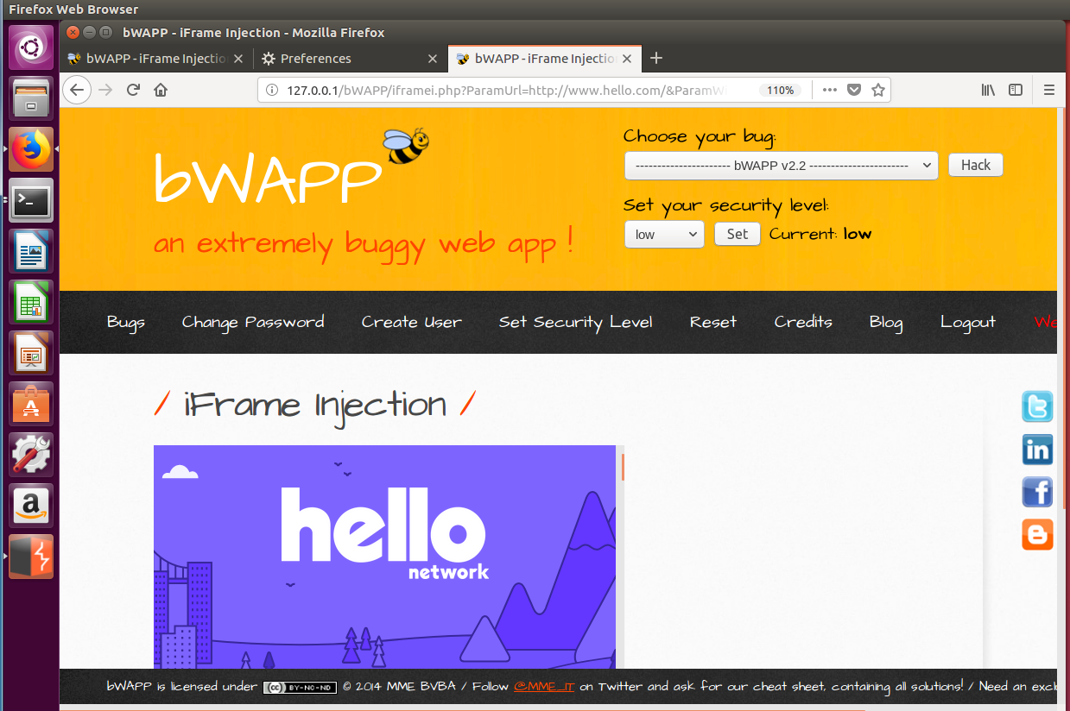
iFrame Injection

Slide 8
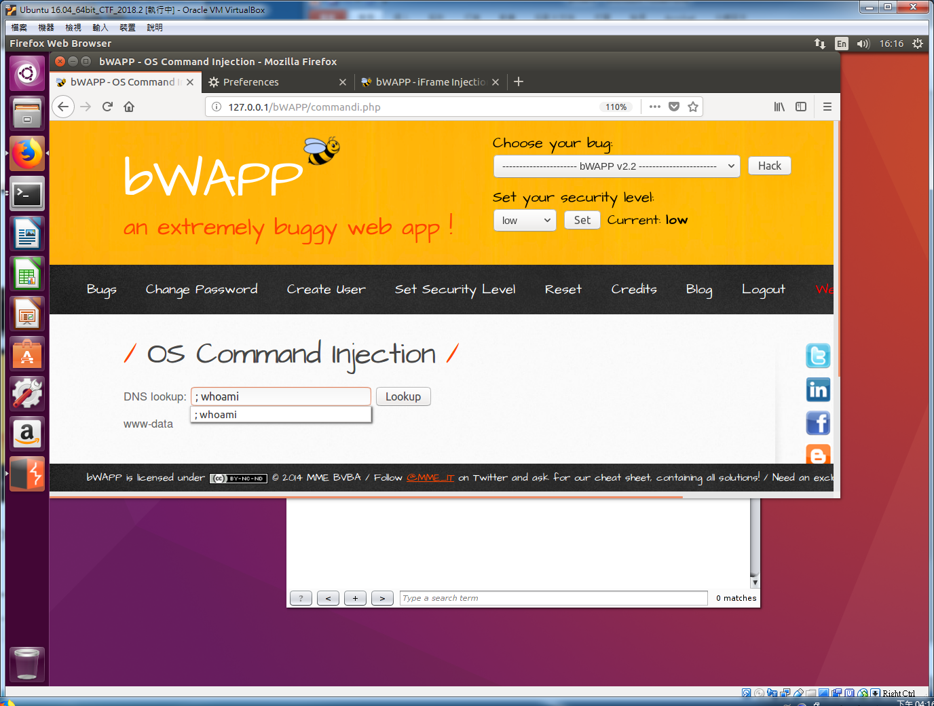
OS Command Injection

Slide 9
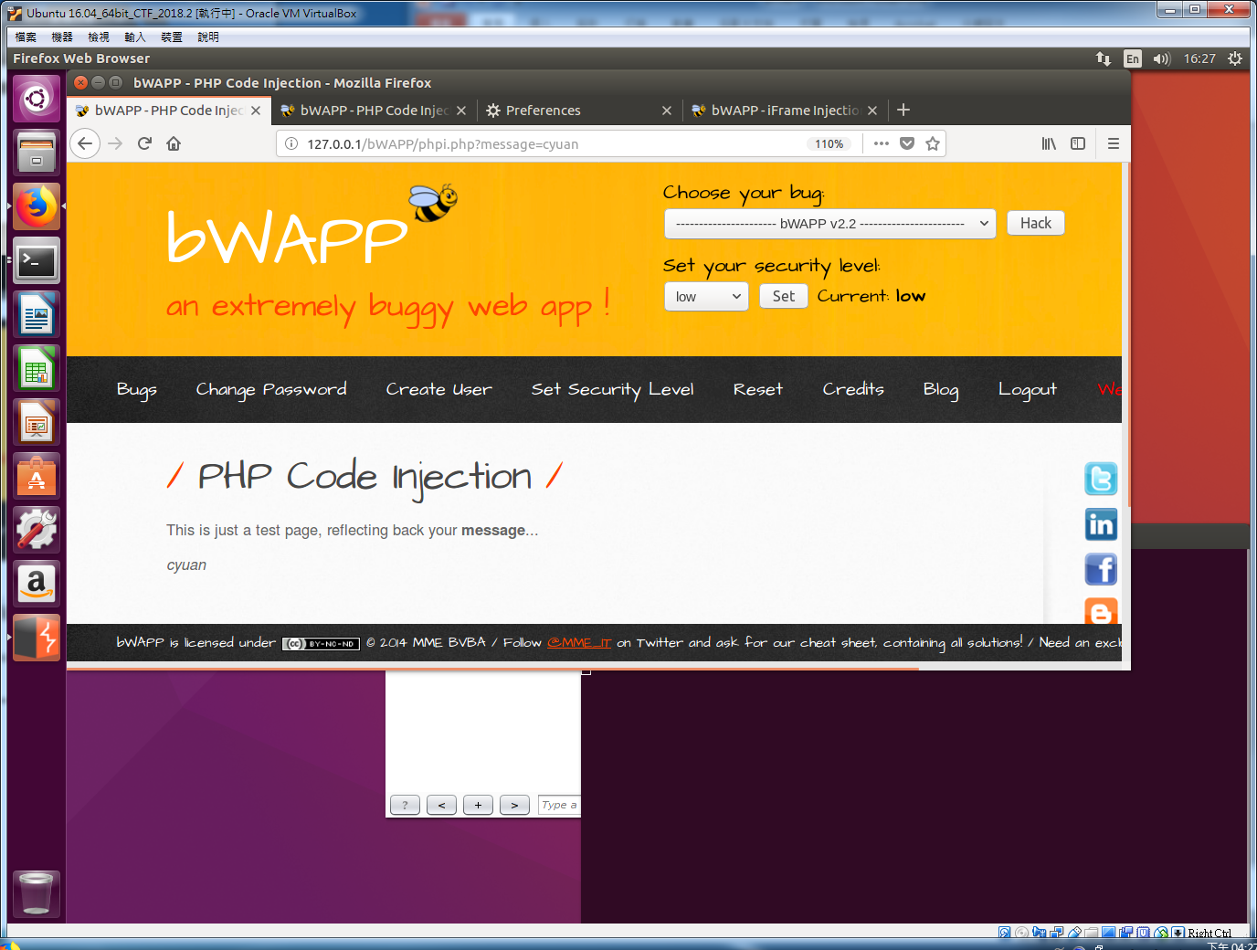
PHP Code Injection
→ message=cyuan

Slide 10
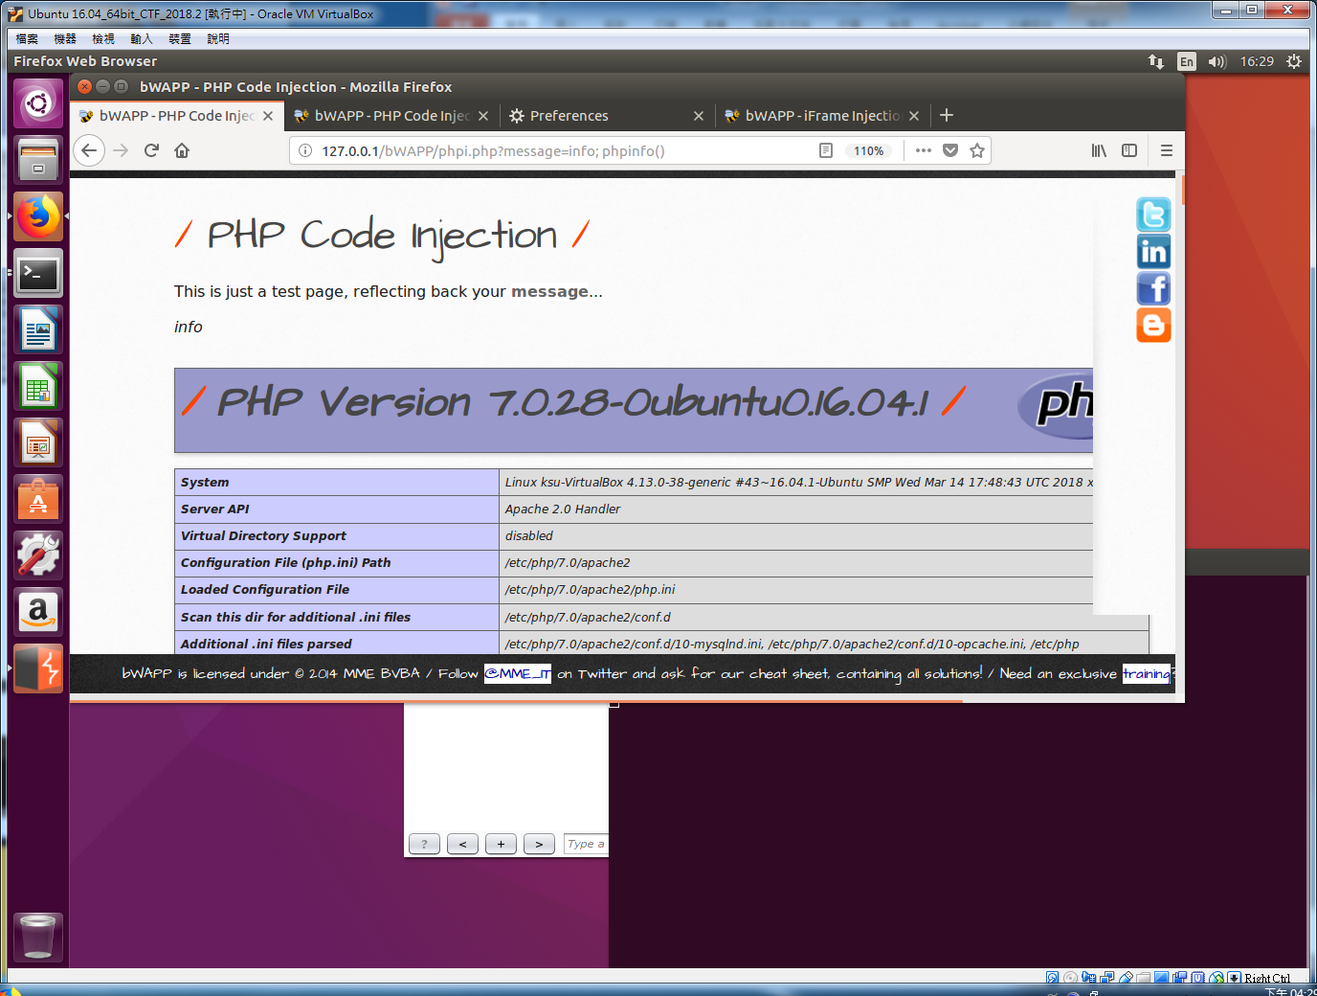
PHP Code Injection
→ message=info; phpinfo()

Slide 11

PHP Code Injection
→ message=info; system('hostname')

